Slide 1
Application of Neural Networks
UNIT 5

Slide 2
Syllabus
Application of Neural Networks in –
Bioinformatics, (slide 3 to 12)
Pattern Recognition, (slide 13 to 70)
Forecasting, (slide 71 to 92)
Image Processing & Compression,
Robotics,

Slide 3
Application of Neural Networks in Bioinformatics

Slide 4
Introduction
Bioinformatics is an interdisciplinary field that develops methods and software tools for understanding biological data, in particular when the data sets are large and complex.
As an interdisciplinary field of science, bioinformatics combines biology, computer science, information engineering, mathematics and statistics to analyze and interpret the biological data.

Slide 5
Introduction
Over the past fifty years , modern science has been trying to unravel the mystery behind “ Human Intelligence” and how to simulate it in artificial conditions.
Since a modern crane can lift weights with magnitudes over thousand times what a human hand can lift then, theoretically, it is possible to simulate human intelligence in machine in those similar orders.
A major approach to solving this challenge of simulating intelligence has been the development of the Neural Network.
The fundamental stimulus behind the notion of the neural network has been the human brain.
Computational scientists and psychologists have collaborated to try to mimic the biological dynamics of the human brain on a logical and artificial paradigm, such as a computer.

Slide 6
Introduction
The basic goal was to break the logical reasoning process into a scattered network where each 'network unit' would inter-communicate and make a decision based on its analysis of the problem to be solved.
With the advent of the Human Genome Project , the area of bioinformatics, especially protein sequencing, has become a major target for neural networks.
Protein sequencing is the practical process of determining the amino acid sequence of all or part of a protein.

Slide 7
Function of the protein
If you do not know anything about the function of a protein then you can analyse the primary sequence using a range of bioinformatics tools to predict its function.
Bioinformatic tools can help you predict the cellular location of the protein, whether or not is an enzyme, or it is modified in some way.
Once you have predicted the function and role of the protein in the cell you can then carry out experiments to test your hypothesis.
If the function of the protein is known then analysing the sequence can help you predict the function of proteins with no known function, or help you spot relationships between proteins that were previously unknown.
Finally, analysis of the sequence of a protein from a 'deseased' cell, when compared to the same protein from a 'healthy' cell, can give you an insight in to how or why the disease comes about.

Slide 8
A Bioinformatics Application for Neural Networks
Due to advancement in genetic engineering especially the advent of the Human Genome Project, the pressure for Molecular competition and Sequencing Technologies have been immensely increased.
Since the Human Genome Project is aiming to map and sequence the entire Human Genome, it is expected that it will generate sequence data that fills a book with the million pages.
In other words it is expected to produce data beyond our current abilities to sequence and interpret, given our present computing ways .
There are many sequencing problems in the area of Bioinformatics for machines to solve and rationalize.
A problem, many scientists believe to be the most significant problem remaining in genetic engineering is Protein Folding.
Some refer to this problem as breaking the second half of the genetic code. Here we shall analyze the impacts of the protein folding problem and how neural networks are impacting its development.

Slide 9
Continued…
Protein folding refers to the problem of predicting a protein’s three-dimensional structure from a one-dimensional amino-acid sequence.
So far, neural networks have shown a lot of promise and initial experimental success towards the protein folding problem.
The protein folding problem is a key initiatives in the field of protein engineering and ‘rational’ drug design.
Traditionally, the protein structure has been predicted using methods such as x-ray crystallography, which involves manual and experimental procedures.
However due to the Human Genome Project, it is becoming impossible for these approaches to keep up with the number of protein sequences needed to be mapped.
As a result the existence of an artificially intelligent process of sequencing is becoming an imminent necessity.

Slide 10
The Protein Folding Problem
The problem can be stated formally as follows. Given the nature of an unlabeled protein sequence S and a known structural super family F, we want to predict if S belongs to F.
From the neural network’s point of view, each input S has a target output, or class, F’ and the prediction accuracy of the neural network is computed by the number of correct identifications of the target for a set of inputs.
The practical application of this scenario would be the following.
If a certain disease X exhibited an amino-acid sequence S, then we may be able to treat the disease X by a combination of drugs, which are used to treat other diseases belonging to F.
This greatly improves our ability in treating diseases since almost always, Drugs and treatments are formed through speculation and intelligent guessing from fast experiences with the other diseases, followed by empirical testing.
Therefore the protein folding solution aims to rationalize the process of speculation and intelligent guessing.
An important step in creating a neural network solution to protein folding is providing the neural network with an input, which is under stable and easily recognizable by the network.

Slide 11
Feature Extraction by Neural Networks
Proteins sequences are expressed by one-dimensional sequences of amino acids.
Amino acids are expressed by the 20-letter alphabets={A,C,D,E,F,G,H,IK,L,M,N,P,Q,R,S,T,V,W,Y}.
An example sequence chain is PVKTNVK.
However it is extremely inefficient to pass this chain to the Neural network system for structural prediction purposes.
A very critical element in the neural system’s accuracy and efficiency is the sequence encoding schemes since its ability to recognize underlying regularities depends on how easily the system can parse and generalize its inputs.
Most of the times, inputs undergo not one but multiple encoding schemes, each intending to extract certain aspect of the given sequence. An encoding, known as the 2-gram amino acid encoding, extracts the occurrence of two letter patterns. In the given patterns above , PVKTNVK, it would yield the following information: PV:1, VK:2, KT:1, TN:1,NV:1.

Slide 12
Feature Extraction by Neural Networks
The 2-gram amino acid encoding can be then used in conjunction to the 2-gram exchange group encoding where a 6-letter exchange group{e1,e2,e3,e4,e5,e6} is used to sequence in the 20-letter amino acid sequence, where e1 € {H,R,K}, e2 € {D,E,N,O}, e3 € {C}, e4 € {S,T,P,A,G}, e5 € {M,I,L,V}, e6 € {F,Y,W}
The PVKTNVK sequence would be represented in the 2-gram exchange group encoding scheme, as e4e5e1e4e2e5e1. such an encoding scheme is used to make the total number of possible inputs a smaller number since it uses a 6-letter alphabet rather than a 20-letter alphabet.
There are many such encoding schemes for converting amino acid sequence into more “neural network friendly” formats for further processing and classifying them into known three-dimensional structures.

Slide 13
Neural Networks in Pattern Recognition

Slide 14
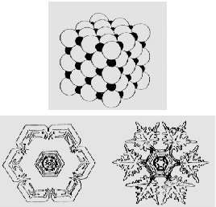
What are Patterns?
Laws of Physics & Chemistry generate patterns.

Slide 15
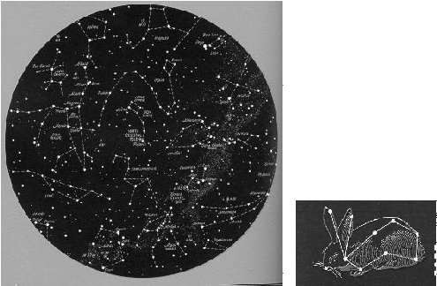
Patterns in Astronomy
Humans tend to see patterns everywhere.

Slide 16
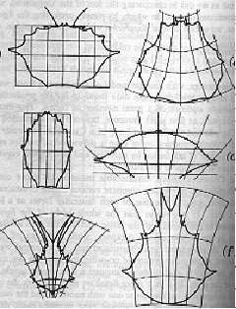
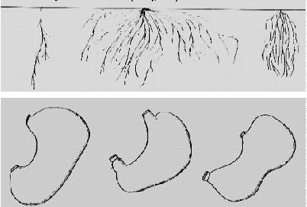
Patterns in Biology
Applications: Biometrics, Computational Anatomy, Brain Mapping.

Slide 17
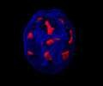

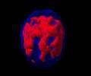
Patterns of Brain Activity
Relations between brain activity, emotion, cognition, and behaviour.

Slide 18
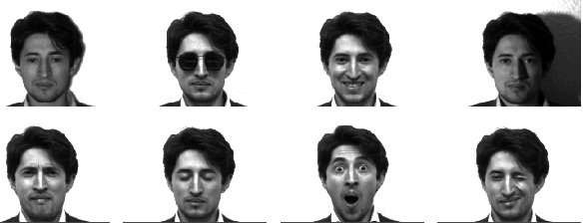
Variations of Patterns
Patterns vary with expression, lighting, occlusions.

Slide 19
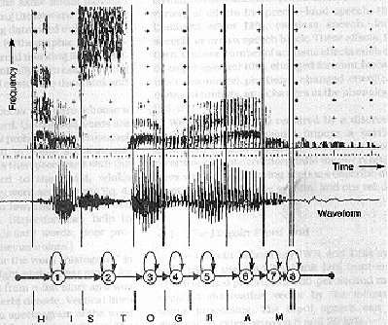
Speech Patterns
Acoustic signals.

Slide 20
Preamble
PATTERN RECOGNITION ⇒ Pattern + Recognition
PATTERN : Pattern is a set of objects or phenomena or concepts where the elements of the set are similar to one another in certain ways/aspects. The Pattern are described by certain quantities, qualities, traits, notable features and so on.
Example : Humans, insects, Animals, clouds etc.
Humans have a pattern which is different from the pattern of animals. Each individuals has a pattern which is different from the patterns of others.

Slide 21



Cloud Patterns

Slide 22


Forest and Cultivated Land

Slide 23
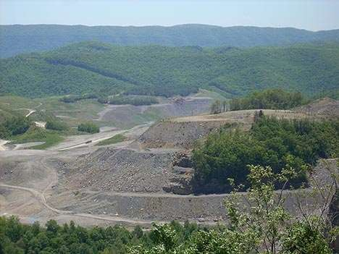
Coal Mine Detection

Slide 24

Natural Gas Detection

Slide 25
Introduction
Pattern recognition is the association of an observation to past experience or knowledge.
Humans continuously perform perceptual pattern recognition, and the amazing complexity of the cognitive process involved has made pattern recognition an active area of search in psychology and neurophysiology for many decades.
With the recent advances in the computing technology, many pattern recognition tasks have become automated.
These include tasks naturally performed by humans, such as speech and handwritten character recognition, as well as the jobs that are unnatural and difficult.
Today useful applications of automatic pattern recognition are common.
As computers and the methods of automatic pattern recognition process, more and more fascinating applications are being discovered in the fields of finance, manufacturing and medicine.

Slide 26
Introduction continued….
Pattern recognition is the science and art of giving names to the natural objects in the real world.
A pattern is essentially an arrangement or an ordering, in which some organization of underlying structure can said to exist.
So a pattern can be referred to as a quantitative or structural description of an object or some other item of interest.
A set of patterns that share some common properties can be regarded as pattern class.

Slide 27
Introduction continued….
It naturally involves extraction of significant attributes of the data from the background of irrelevant details, for example
Speech recognition maps a waveform into words
Character recognition maps a matrix of pixels into characters and words
The pattern recognition solution involves many stages such as making the measurements, preprocessing and segmentation, finding a suitable numerical representation for objects we are interested in, and finally classifying them on these representations.

Slide 28
Pattern Recognition
It is said that each thief has his own patterns. Some enter through windows, some through doors and so on.
Some do only ‘pick-pocketing’, some steal cycles, some steal cars and so on.
The body pattern of human beings has not changed since millions of years.
But pattern of computers and other machines continuously change.
Because of the fixed pattern of human bodies, the work of medical doctors is easier compared to the work of engineers who deal with machines whose patterns continuously change.

Slide 29
Pattern Recognition
Pattern recognition is the study of how machines can observe the environment, learn to distinguish patterns of interest from their background, and make sound and reasonable decisions about the patterns' categories.
Some examples of the pattern are - fingerprint images, a handwritten word, a human face, or a speech signal.
Given an input pattern, its recognition involves the following task –
Supervised classification - Given the input pattern is known as the member of a predefined class.
Unsupervised classification - Assign pattern is to a unknown class.

Slide 30
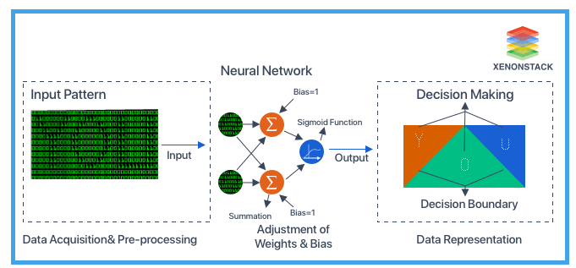
Pattern Recognition

Slide 31
Continued….
So, the recognition problem here is essentially a classification or categorized task. The design of pattern recognition systems usually involves the following three aspects-
Data acquisition and preprocessing
Data representation
Decision Making

Slide 32
Pattern Recognition
RECOGNITION
Recognition  Re + Cognition
COGNITION:- To become acquainted with, to come to know the act, or the process of knowing an entity (the process of knowing).
Recognition : The knowledge or feeling that the present object has been met before (the process of knowing again).

Slide 33
Pattern Recognition
Pattern Recognition consists of recognizing a pattern using a machine (computer). It can be defined in several ways.
DEFINITION.1.:- It is a study of ideas and algorithms that provide computers with a perceptual capability to put abstract objects, or patterns into categories in a simple and reliable way.
DEFINITION 2: Pattern recognition can be defined as the classification of data based on knowledge already gained or on statistical information extracted from patterns and/or their representation.

Slide 34
Applications of Pattern Recognition
Handwritten digit/letter recognition
Biometrics: voice, iris, fingerprint, face, and gait recognition
Speech recognition
Smell recognition (e-nose, sensor networks)
Defect detection in chip manufacturing
Interpreting DNA sequences
Fruit/vegetable recognition
Medical diagnosis Terrorist Detection Credit Fraud Detection Credit Applications.
… …

Slide 35
Applications
Pattern Recognition covers a wide spectrum of disciplines such
As
Computer Science
System Science
Communication Sciences
Electronics
Mathematics
Logic
Psychology
Philosophy

Slide 36
Approaches of Pattern Recognition
The three best-known approaches for pattern recognition are:
1) Template matching: Template Matching is used to determine the similarity between two entities (points, curves, or shapes) of the same type. The pattern to be recognized is matched with a stored template along with geometrical transformations. This approach has some obvious disadvantages of being too rigid and having the need for lots of templates.
2) Statistical classification: In this method, each pattern is represented in terms of some features or measurements. The main objective of this approach is to establish decision boundaries in the feature space. This separates patterns belonging to different classes creating some rules for an inter-class boundary.
3) Syntactic or structural matching: This method works on a hierarchy framework where a pattern is said to be composed of simple sub-patterns that are themselves built from yet simpler sub-patterns. Considered equivalent to languages where primitives are alphabets which make words then lines than the page and then documents.

Slide 37
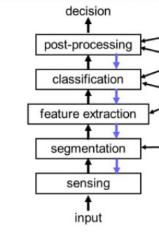
Structure of a pattern recognition system

Slide 38
Structure of a pattern recognition system
a) The sensor converts images or sounds or other physical input into signal data.
b) Segmentation is the part which enables segregating sensed object from the background noise.
c) The feature extractor measures object properties and select those features that are important for classification.
d) The classifier uses these features to assign the sensed object to a category.
e) Finally, the post-processor can take account of other considerations such as the cost of the error to decide appropriate action.

Slide 39
Advantages and Disadvantages
Advantages:
Pattern recognition solves classification problems
Pattern recognition solves the problem of fake bio metric detection.
We can recognize particular object from different angle.
Disadvantages:
Syntactic Pattern recognition approach is complex to implement and it is very slow process.
Sometime to get better accuracy, larger dataset is required.

Slide 40
Architectures
Following Neural Network architectures used for Pattern Recognition –
Multilayer Perceptron
Kohonen SOM (Self Organizing Map)
Radial Basis Function Network (RBF)

Slide 41
Handwritten Character Recognition(Pattern Recognition)

Slide 42
Handwritten character Recognition
Handwriting character recognition is a technique or ability of a Computer to receive and interpret handwritten input from source such as paper documents, touch screen, photo graphs etc.
Handwritten character recognition may for instance be applied to zip code recognition, automatic printed form acquisition, or checks reading. The importance of these applications has led to intense research for several years in the field of off-line handwritten character recognition.
It is a hard task for the machine because handwritten digits are not perfect and can be made with many different flavors.
The handwritten digit recognition is the solution to this problem which uses the image of a digit and recognizes the digit present in the image.

Slide 43
Problem in the recognition of handwritten character
There are different challenges faced while attempting to solve this problem.
The handwritten digits are not always of the same size, thickness, or orientation and position relative to the margins.
Similarity of some character with each other for ex: the digits like 1 and 7, 5 and 6, 3 and 8 ,9 and 8 etc.
Also people write the same digit in many different ways.
Finally the uniqueness and variety in the handwriting of different individuals also influences the formation and appearance of the digits.
Variability of someone’s calligraphy over time.

Slide 44
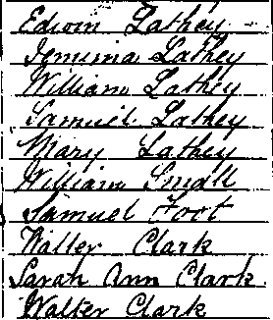
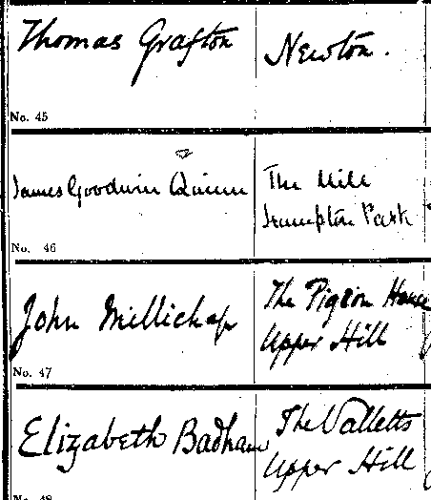
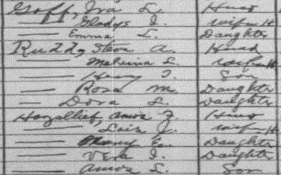
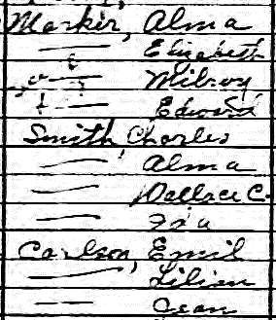
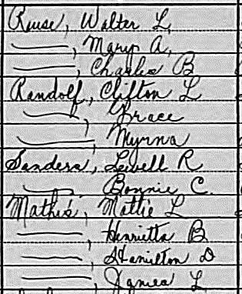
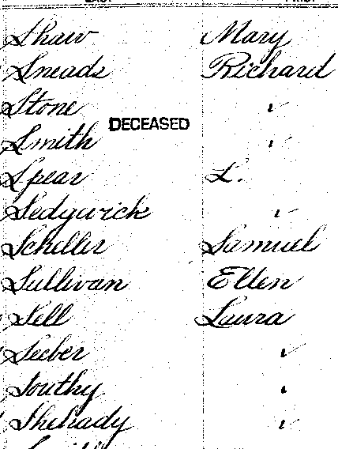

Slide 45
Types of Handwriting Recognition
Online recognition
Offline recognition

Slide 46

On-line handwriting recognition involves the automatic conversion of text as it is written on a special digitizer or PDA, where a sensor picks up the pen-tip movements as well as pen-up/pen-down switching. That kind of data is known as digital ink and can be regarded as a dynamic representation of handwriting.
The obtained signal is converted into letter codes which are usable within computer and text-processing applications.
The elements of an on-line handwriting recognition interface typically include:
a pen or stylus for the user to write with.
a touch sensitive surface, which may be integrated with, or adjacent to, an output display.
a software application which interprets the movements of the stylus
across the writing surface, translating the resulting strokes into digital text.

Slide 47

Off-line handwriting recognition involves the automatic conversion of text in an image into letter codes which are usable within computer and text-processing applications.
The data obtained by this form is regarded as a static representation of handwriting.
Off-line handwriting recognition is comparatively difficult, as different people have different handwriting styles.
And, as of today, OCR engines are primarily focused on machine printed text and ICR for hand "printed" (written in capital letters) text.
There is no OCR/ICR engine that supports handwriting recognition as of today.

Slide 48
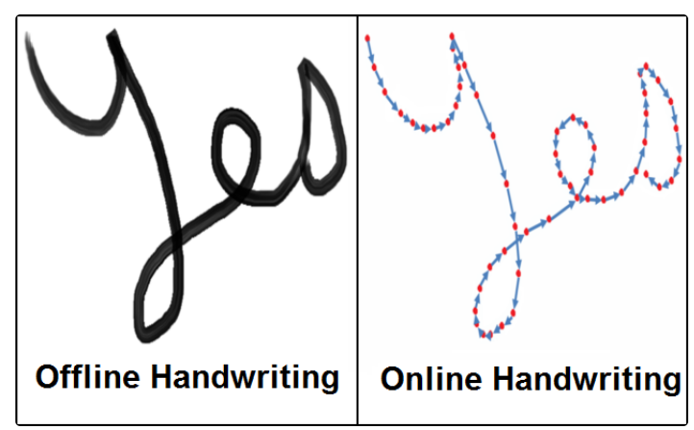
Offline Vs. Online Recognition

Slide 49
Neural Network Approach

Slide 50
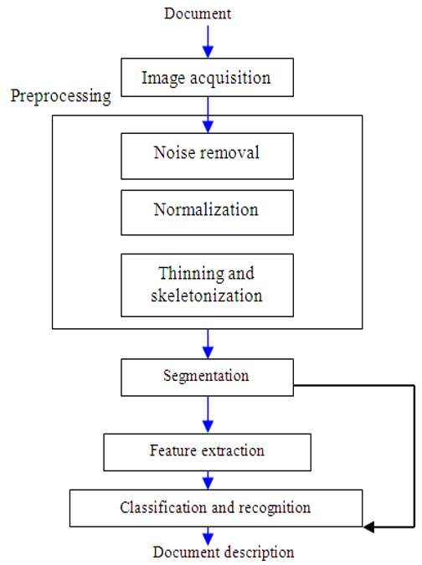
Framework
Steps:
Fig. 3: A general diagram for Arabic digit recognition system

Slide 51
Steps
Image acquisition:
We will acquire an image to our system as an input, this image should have a specific format, for example, bmp format and with a determined size such as 30x20 pixels. This image can be acquired through the scanner or, digital camera.
Preprocessing:
After acquiring the image, it will be processed through sequence of preprocessing steps to be ready for the next step.

Slide 52
Noise removal:
Reducing noise in an image. For on-line there is no noise to eliminate so no need for the noise removal. In off-line mode, the noise may come from the
writing style or from the optical device captures the image.
Normalization-scaling:
Standardize the font size within the image. This problem appears clearly in
handwritten text, because the font size is not restricted when using handwriting.
Thinning and skeletonization:
Representing the shape of the object in a relatively smaller number of pixels. Thinning algorithms can be parallel or sequential.
Parallel is applied on all pixels simultaneously.
Sequential examine pixels and transform them depending on the preceding processed results.

Slide 53
Segmentation:
Since the data are isolated, no need for segmentation. With regards to the
isolated digits, to apply vertical segmentation on the image containing
more than digit will isolate each digit alone.
Classification and recognition:
Neural Network is a network of non-linear system that may be characterized according to a particular network topology. Where, this topology is determined by the characteristics of the neurons and the learning methodology. The most popular architecture Of Neural Networks used in this digits recognition takes a network with three layers. These are: Input layer, hidden layer and output layer. The number of nodes in the input layer differs according to the feature vector’s dimensionality of the segment image size.

Slide 54
Continued…….
In the hidden layer the number of nodes governs the variance of samples which can be accurately and correctly recognized by this Network.
In addition, back propagation algorithm is used. Neural networks are trained, so that a particular input leads to a specific target output. There, the network is adjusted, based on a comparison of the output and the target, until the network output matches the target.

Slide 55
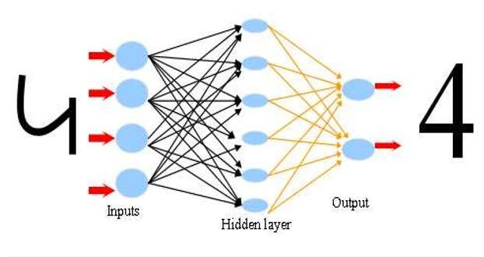
Scenario of number recognition with ANN
the scenario of number recognition with Artificial Neural Network which contains
input and hiding layer and output with the number (4) for examination the Network.

Slide 56
Neural Network Models:
Two networks model are used:
Two Layer Network Model
Three Layer Network Model
In both the network we applied feed forward back propagation neural
network algorithm.

Slide 57
Two Layer Network Model
The first network (two layers) shown in next slide consisted of an input layer P1 of a vector of 600 inputs and an input weights IW1,1 of 50×600 and b1 a vector bias with 50 biases connecting the input vector with the hidden layer which consist of 50 neurons. n1 = IW1,1 P1+ b1 represents the input for the 50 neurons of the hidden layer. a1 is the output of 50 neurons of the hidden layer resulted of applying an activation function on n1, a1 is now is the input vector of the next layer which is here the output layer.
LW2,1 of 10×50 represents layer weights and b2 a vector bias with 10 biases which connects the hidden layer with the output layer which consist of 10 neurons. n2 = IW2,1 a1+ b2 the input for the 10 neurons of the output layer. a2 is the output of 10 neurons of the output layer resulted of applying an activation function on n2.
The output layer of the first network consist of 10 neurons since we need to classify 10 digits [0,1,…,9], each of which correspond to one of the possible digits that might be considered.

Slide 58
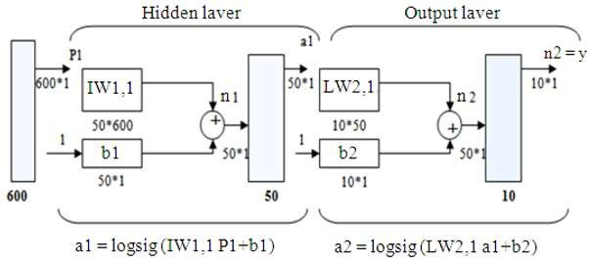
Two layers network, one hidden and one output with 50, 10 neurons respective

Slide 59
Three Layer Network Model
The architecture of the second network (three layers) as illustrated in next slide also is the same as the architecture of the first network except that there are an additional hidden layer rather than one hidden layer.
The input vector also consists of 600 inputs.
There are two hidden layers, the first consists of 250 neurons and the second consists of 6 neurons. The output layer also consists of 10 neurons.
Also the same as in the first network, each neuron is used to correspond to one of the possible digits that might be considered.

Slide 60
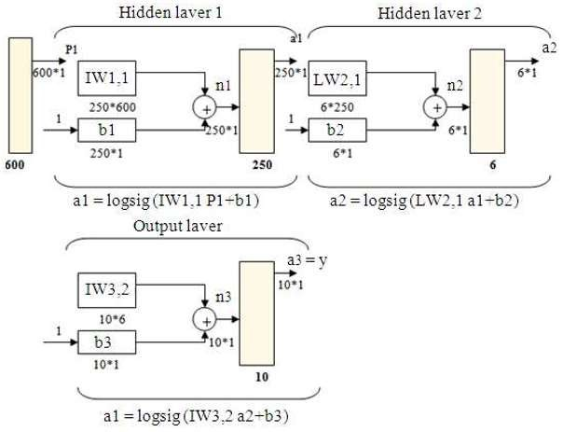
Three layers network, two hidden and one output, with 250,6,10 neurons respectively for each layer.

Slide 61
Continued…
Both networks are fully connected feed forward network, which means activation travels in a direction from the input layer to the output layer and the units in one layer are connected to every other unit in the next layer up.
The back propagation algorithm consists of three stages. The first is the forward phase, spread inputs from the input layer to the output layer through hidden layer to provide outputs.
The second is the backward stage, calculate and propagate back of the associated error from the output layer to the input layer through hidden layer.
And the third stage is the adjustment of the weights.
The backward stage is similar to the forward stage except that error values are propagated back through the network to determine how the weights are to be changed during training.
During training each input pattern will have an associated target pattern. After training, application of the net involves only the computations of the feed forward stage.

Slide 62
Printed character recognition(Pattern Recognition)

Slide 63
Definition
Character Recognition is the mechanical or electronic conversion of images of typewritten or printed text into machine-encoded text.

Slide 64
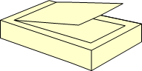
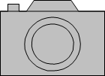


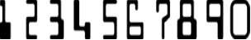
Introduction to Character Recognition
▶ 1 2 3 4 5 6 7 8 9 0

Slide 65
USES
It is widely used as a form of Data Entry from Printed Paper data records, whether Passport Documents, Invoices, Bank Statements, Business Card, Mail or Other Documents.
It is common method of Digitizing Printed Texts so that it can be Electronically edited, searched, stored more compactly, displayed on-line, and used in Machine Processes such as Machine Translation, Text-to-Speech, Key Data and Text Mining.

Slide 66
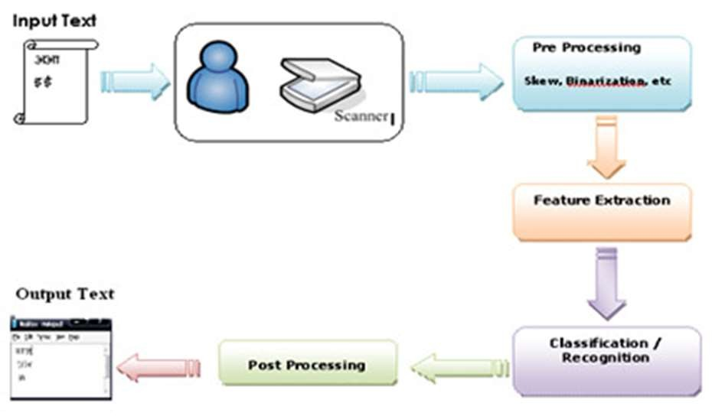
Steps in Character Recognition

Slide 67


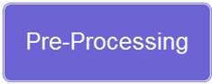




Steps in Character Recognition

Slide 68
Pre - processing
Deals with Improving quality of the Image for better recognition by the system. Character Recognition software often "pre-processes" images to improve the chances of successful recognition.

Slide 69
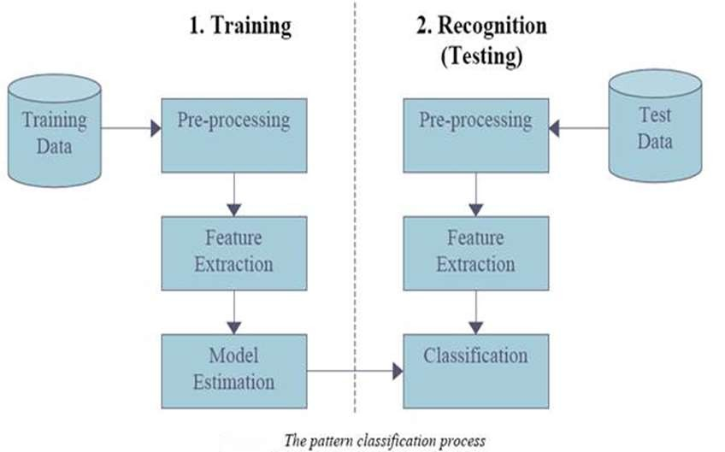

Slide 70
Post - processing
▶ Character Recognition accuracy can be increased if the output is constrained by a lexicon – a list of words that are allowed to occur in a document. This might be, for example, all the words in the English language, or a more technical lexicon for a specific field. This technique can be problematic if the document contains words not in the lexicon, like proper nouns. Tesseract uses its dictionary to influence the character segmentation step, for improved accuracy.

Slide 71
Neural Network in Forecasting

Slide 72
Introduction
Most forecasting techniques used today are based upon traditional linear or non-linear statistical models, such as regression analysis.
Although these models are useful and have been utilized for many years to predict, the models are somewhat limited in their ability to forecast in certain situations.
Given the changing nature of technology and the globalization of business and financial markets, it is becoming increasingly important to be able to more quickly and accurately predict trends and patterns in data in order to maintain competitiveness.
More specifically, it is becoming increasingly important for forecasting models today to be able to detect non-linear relationships while allowing for high levels of noisy data and chaotic components.

Slide 73
Introduction continued…
In the light of changing business environment managers are feeling the need for more flexible forecasting models.
Specifically, forecasting models need to better allow for processing large amounts of data or generating from many sources and many locations.
Currently, however, most of the processing of information that occurs in business is done by utilizing computers that process information sequentially from a single central processing unit.
This Processing unit generates a result directly from the hard coding of the problem into the computers by a programmer.
Due to the need for improved and advanced processing, businesses have turned focus on the idea that there is the potential for information processing to take place through mechanisms other than traditional models.

Slide 74
Introduction continued…
One specific method of information processing that is being focused upon today utilizes a system that mirrors the organization and structure of the human nervous system.
Such a system would consist of “parallel” computers equipped with multiple processing elements aligned to operate in parallel to process information.
This method of forecasting is referred to as neural networking at and is accomplished through a forecasting tool that has become known as artificial neural network (ANN).
Such networks have been used in the medical, science, and engineering fields.
Now this technology is expanding to additional disciplines and is increasingly popular as a superior forecasting tool in today's business environment.

Slide 75
Operations of a Neural Network
A neural network is an information processing model based on the functioning of the neurons or nerve cells, found in the human brain and nervous system, researchers are able to create an information processing system for use in forecasting that operate in the same manner as a human nervous system.
In a neural network model, information is processed through interconnected networks that work to transfer information through a signaling process.
The neural networks are typically made up of three layers of neurons: input layers, hidden layers and output layers.
Also within this model are assigned weights representing the knowledge base of the system and a transfer function that is used to process the data and represents the non-linear properties of the neuron.

Slide 76
Operations of a Neural Network cont…
Although these three layers, the assigned weights, and the transfer function make up the typical neural network structure, there are many choices when designing such a network.
For example, all layers and neurons can vary in number depending on the characteristics, such as amount and nature of the data to be used and the desired output result.
More specifically, although using one hidden layer is adequate to map any input/output relationship, it may not be the most appropriate design in certain forecasting circumstances.
This is also the case with the output layer.

Slide 77
Operations of a Neural Network cont…
The input layer is a first layer of the neurons and is where all of the known external variables and data is input.
Each input neuron represents a separate variable and various line connectors join these input layers with the middle, or hidden layers of the network.
The connectors are assigned weights according to the level of importance since they are the location of the knowledge pool that exists within the network.
The basic process that occurs between the input and hidden layers begins with the inputting of the external data.
The values of this input data are then multiplied by the appropriate weights, as determined by the back propagation algorithm, and summed within the hidden layer. This sum is then converted through a transfer function into an output value.
This output value is in the last layer, known as the output layer and typically contains only one neuron since only one output is usually requested.
One output is typically recommended because determining more than one output has proven to generate less than desirable results.

Slide 78
Operations of a Neural Network cont…
Since the neural network operates to process data in the same manner as the human brain functions, the neural network needs the ability to “learn” information as opposed to being “programmed”.
This learning ability of the neural network is accomplished through intense training of the network by providing it with numerous, reliable, and correct examples.

Slide 79
Operations of a Neural Network cont…
During the training phase, the overall goal is to determine the most accurate weights to be assigned to the connector lines.
Also during training, the output is computed repeatedly and the result is compared to the preferred output generated by the training data.
Any variance is considered a training error and it is important for this training error to be as small as possible so that the forecasted output is reliable.
In order to minimize this error, the originally assigned weights are adjusted until the error declines.
This weight adjustment is accomplished through the use of algorithm.
By adjusting the weights, the error in minimized continuously until a point is reached that represents the least amount of acceptable error.
At this point an accurate forecasts can be produced.

Slide 80
Advantages of Neural Networks
The purpose of using neural network is to be able to forecast data patterns that are too complex for the traditional statistical models.
Although neural networks are quickly becoming the wave of the future for forecasting, they continue to have both advantages and disadvantages.
A strong advantage of neural network is that, when properly trained, they can be considered experts with regard to the particular output project for which they were designed to examine.
This network structure can even be used to “provide projections given new situations and answer “what-if” questions.

Slide 81
Advantages of Neural Networks conti…
In addition, the learning ability of neural networks allows them to adjust to dynamic and changing market environments and is a much more flexible forecasting tool than traditional statistical models.
An example of this level of flexibility is in the area of forecasting net asset value of mutual funds.
When compared to regression analysis, neural network forecasting in this area was shown to generate a 40% increase in accuracy.
This higher performance level is mainly attributed to the flexibility of the neural network and the ability to take into account all variables, internal and external, as well as the relationships between them.
Furthermore, neural network systems are able to detect patterns and trends in any set of data they are given, including highly unorganized and variable data.
As such, many businesses are continuing to increase the uses of neural networks in various areas of their operations in order to increase and improve the competitiveness.

Slide 82
Disadvantages of Neural Networks conti…
There are, however critics who point out the disadvantages of using neural networks as forecasting tools.
First, the design of the neural network is a very complex procedure that still relies mostly on trial and error. This is due to the necessity to determine the appropriate input variables and the necessary level of training of the system.
The training process is time-consuming, and must be continuously repeated to account for changes in values of the variables. Without the recurring retraining, the accuracy of the neural network will decline.
In addition, because the neural network can only produce accurate results if provided with an accurate training set. it is necessary to use large volumes of precise examples in the training phase.
It is also important for the network designer to recognize the possibility of over-training when designing the neural network. This “over-fitting” occurs as a result of the large amounts and chaotic nature of the data coupled with few training sets. The danger here is that if over-fitting occurs, the neural network forecast will be too inaccurate.

Slide 83
Disadvantages of Neural Networks conti…
Neural networks are also criticized because of the unstable nature of the problem solving and the often inability to repeat a process and obtain the same results.
Because the data are constantly changing, it is very difficult to repeat a solution to a problem. This therefore, makes it very difficult to follow the methods the network is using to reach the output forecast.
Thus, the most often and disadvantage of the neural network is the inherent in and “black-box” nature of its operations.
Neural networks, although able to generate a solution to many problems, are unable to explain how they arrive at their results. As such, neural networks are considered “black boxes” whose “rules of operation are completely unknown”.
This causes many to be wary of relying heavily on the results form a system they cannot truly understand.

Slide 84
Applications in Business
The use of neural network in business environments have been increasing over the last few years. Many areas of business, especially finance, utilize neural networks to improve forecasting of their business applications and to create new methods of evaluating financial data and the an investment decisions.
Neural networks are being used specifically by companies for improved forecasting capabilities in analysis of the stock market. Neural network systems are being used to predict short-term stock performance. For example, a neural network system referred to as the “Short Term Stock Selector” is available for use through an attractive website. This website utilizes neural network software application to generate a decision regarding the near-term trading of a particular stock.

Slide 85
Applications in Business conti..
Another example of neural network application in the stock market involves Daiwa Securities Company.
This company utilizes neural network technology to learn and recognize stock price patterns for use in price forecasting.
Currently, the neural network systems used by Daiwa Securities Company has been trained to analyze 1,134 company's stock market price patterns.
This information is then used to forecast future stock price fluctuations for this particular companies.

Slide 86
Applications in Business conti..
In addition, neural network technology has been applied to forecasting activities for entire financial markets and financial indexes.
O'Sullivan Brothers Investments Limited has utilized neural network software to follow over twenty different financial Markets and generate reports regarding the behavior of any of the studied markets.
More specifically, this particular neural network system will generate information such as the probability of a certain price occurring in the next time period, as well as the most optimal target long and short-term prices.
Still another product of this particular neural network can notify the user as to what level must be reached for the overall market to experience an increase.
Similarly, in the future market, predictions are also being made with neural network systems.
Neural network technology has been applied in predicting corn futures.
In such applications, the study concluded that when compared to traditional forecasting models used in this area, the neural network produced between 18 and 40 percent fewer errors.

Slide 87
Applications in Business conti..
Neural networks have also been used in determining bond ratings.
Traditionally, bond ratings have been chosen as a result of statistical regression analysis.
By utilizing neural networks to determine bond’s rating, additional important factors affecting the potential default risk, can be accounted for. Unlike statistical regression analysis, the less obvious variables affecting default risk can be taken into account.
Studies show this method of determining bond ratings has provided between 95% 100% accuracy, while statistical regression analysis has been 85% accurate.
In addition to bond ratings, bond prices can also be predicted with neural networks.
Currently, G. R. Pugh & Company of New Jersey utilizes neural networks to predict bond prices of 115 public utility companies.
The company relies heavily on this technique when advising clients of potential investment opportunities.

Slide 88
Applications in Business conti..
Bank loan decisions are another area in which neural networks are proving useful.
Because the decision to make or deny a loan is very subjective or nonlinear in nature, the use of neural networks resulted in a significant improvement in the decision-making process.
By utilizing a neural network, the banker can rely on the network to “recognize certain similarities and patterns ” and make a more accurate prediction with regard to potential defaults on a loan.
Corporations today are finding ways to utilize neural technology to improve overall business operations including the computer capabilities within the company.
Computer Associates, for example, designed a neural network system called Neugents that predict the future failure of their in-house computer servers.
As described by Charles wang of Computer Associates:” Neugents is unlike other “rule-based” systems which must be fed knowledge of analyze in that it derives the rules of analysis by itself.
It makes all of the new chaotic data and it says, Ok, let me take a good look at what causes and what correlates.
The beauty is that when you start to look at causation you can start to predict.

Slide 89
Applications in Business conti..
The ability to forecast server downtime has been advantageous to companies such as Computer Associates because such predictions make it possible for the company to fix any potential network problem prior to complete computer network failure.
Unlike the area of finance, there are currently available and reliable studies that have been completed in the area of forecasting macroeconomic variables with neural networks.
However there appears to be a growing interest in using neural network systems to forecast microeconomics variables.

Slide 90
Applications in Business conti..
As a result, there are discussions regarding the need for studies that examine the effectiveness of neural network in this area.
One study that has been completed in this area looked at the forecasting accuracy of neural networks for Gross Domestic Product (GDP) predictions.
In this study, forecasting(GDP) with neural networks was proven to provide more accurate predictions when compared to traditional statistical forecasting techniques.
Specifically, in the study completed by Greg Tkacz and Sarah Hu of the bank of Canada, it was determined that on average, the best neural networks yield forecast that are 15 to 19 percent more accurate than the corresponding linear models for the 4-quarter growth rate of the real output.

Slide 91
Applications in Business conti..
In addition to applications mentioned above, neural network technology had been utilized in other areas of business.
For example, neural network systems are being used by manufacturer to better determine adequate new raw materials levels and credit card companies are utilizing the technology for network technology for discovering and monitoring fraudulent activities.
Sales forecasts are also being improved through neural network technology at both the wholesale and retail levels.
Chase Mahhattan Bank maintains a large neural network system that they utilized for determining the creditworthiness of various potential loan recipients.
It is important for the bank to be better able to access such creditworthiness since they are such a large supplier of funds for business.

Slide 92
Applications in Business conti..
The business must continue to adjust and adapt to changes is the business environment in which they operate and be able to deal with the dynamic nature of the global market.
By utilizing neural networks, businesses are hoping to improve their abilities to predict patterns and trends in data.
This would then allow them to better analyze business decisions as well as offer improved products and services to their customers.
However, as researchers have pointed out, it is important to remember that neural network technology does not have to be considered a replacement for the traditional forecasting tools.
Researchers have declared that the best way to view neural network system is as an important complement to other forecasting tools.
With this in mind, utilizing neural network systems together with other forecasting techniques can be considered yet another valuable advancement in the age of technology

Slide 93
Image Processing and Compression using Neural Network

Slide 94
Compression using Neural Network
Windows based Neural Network Image compression and Restoration
Application of Artificial Neural Networks for Real Time Data Compression
Image compression using Direct Solution Method Based Neural Network
Application of Neural Networks to Wavelet Filter Selection in Multispectral Image Compression

Slide 95
1. Windows based Neural Network Image compression and Restoration

Slide 96
Introduction
Data compression is used nearly everywhere on the internet - the videos you watch online, the images you share, the music you listen to, even the blog you're reading right now.
Compression techniques make sharing the content you want quick and efficient.
Without data compression, the time and bandwidth costs for getting the information you need, when you need it, would be very costly.

Slide 97
Introduction
All image data comprises huge size into memory. For this purpose, it needs compression, which has high compression rate. But high compression rate causes some distortion and losses.
Restoration is a process by which an image suffering from some form of distortion or degradation can be recovered to its original form.
The image compression techniques are divided into two main categories such as
Lossless , or reversible compression
Lossy or irreversible compression

Slide 98
Lossless Vs. Lossy compression
The lossy compression technique does not restored the data in its original form, after decompression.
Lossless compression restores and rebuilt the data in its original form, after decompression.
A combination of lossless and lossy compression is advantageous if only a subset of the data set is of interest to the physician and engineer.
Lossy compression is also needed to facilitate fast browsing through a large database of images, since a rough data preview may be performed easily and efficiently by a lossy encoded version of the original data-set.
In lossy compression algorithms we can obtain high compression rates but the MSE(Mean Square Error) also increases. Because of this problem, we have to reduce noise of the image as a Mean Square Error, and restoration by using three neural networks structures for the images.

Slide 99
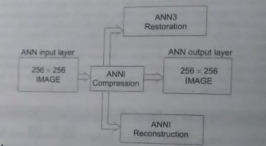
Block Diagram of ANN technique

Slide 100
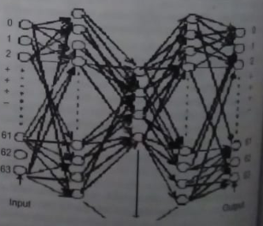
ANN Architecture for image compression

Slide 101
1.1 Image compression and Decompression using Neural Network
Image compression is a process of reducing the number of bits required to represent an image.
There are a various techniques of lossy image compression such as vector quantization; transform coding , predictive coding and block truncation coding are some of the lossy compression techniques.
ANN can also be used for image compression and reconstruction.
The basic block back propagation network can be further extended to construct a multi-layered perceptron neural network by adding two more hidden layers into the existing network, in which the three hidden layers are termed as combiner layer, compressor layer and decombiner layer respectively.
The training scheme applies the complete training set simultaneously to all neural networks and use signal-to noise ratio to roughly classify the image blocks into the same number of subsets as that of neural networks.
After this initial coarse classification is completed, each neural network is then further trained by its corresponding refined sub-set of training blocks. All the image blocks roughly trained the neural network.

Slide 102
1.2 Image Restoration Using Neural Networks
The training of weights in the neural layer by usual learning algorithms or estimation by simple calculations is an interesting alternative to classical methods.
The adjustment of weights makes a fitting quality criterion necessary. This criterion can be varied according to the demands of the application.
In image restoration the output of the correcting system should be as much equivalent to the original object intensity distribution as possible.
Here, an adaptive three neural network algorithms were presented. The presented neural network algorithms have been divided such as image compression, decomposition, and restoration.
First the image is compressed using ANN1, and then this compressed image is reconstructed by ANN2. This reconstructed image has some distortion and lossy. So the last stage the recostructed image is restored by ANN3.

Slide 103
2. Application of Artificial Neural Networks for Real Time Data Compression

Slide 104
Introduction
In today’s world of global communications, people seek information almost as soon as it is made available.
A classic example of this is news reporting where broadcasting companies compete with each other to deliver high qualities of broadcast/telecast.
This is now increasingly possible due to the development of higher data rates in communication as well as newer technologies for delivering us that information instantaneously.
One such area of communication is the Internet where the number of users double each year.
This puts increasing pressure on the communications bandwidth available.
One way of mitigating such effects is to adopt a method of compression that works in real time.

Slide 105
Continued…
Data compression techniques often involve compact representations by identifying and using structures within the data itself.
These structures usually have some degree of variance between themselves.
An ANN approach helps simplify the recognition of these complex variances and subsequently the classification of theses data.
Real time data compression involves the identification of the probability distribution function(PDFs) or the density of each of the features for each file containing such data. By using this ANN approach for data classification, one can then decode a Huffman data compression engine. If this scheme could be employed on an Internet Service Provider(ISP) server, then at the user end a decoder(a Huffman decoder engine) could retrieve the original values.
The objective of this method is to demonstrate a scheme for compressing data based on the feature content of the data present within html files, which make up the bulk of all Internet related formats. It is based on some experimental work involving Self-Organizing Maps and a Huffman encoder/decoder engine.

Slide 106
3. Image Compression using Direct Solution Method Based Neural Network

Slide 107
Introduction
This technique includes steps to break down large images into smaller windows and to eliminate redundant information. Furthermore, the technique employs a neural network trained by a non-iterative, direct solution method.
An Error Backpropagation (EBP) algorithm is also used to train the neural network, and both the training algorithms are compared.
A number of experiments have been conducted. The results obtained, such as compression ratio and transfer time of the compressed images are presented.
The result convey information about the compression ratio achieved, the quality of the image after decompression, and a comparison of the transfer time of both original and compressed images over the communication line.

Slide 108
Introduction
The transport of images across communication paths is an expensive process. Image compression provides an option for reducing the number of bits in transmission.
This in turn helps increase the volume of data transferred in a space of time, along with reducing the cost required.
It has become increasingly important to most computer networks, as the volume of data traffic has begun to exceed their capacity for transmission.

Slide 109
Direct Solution Method Based Neural Network
Here presented a brief description of a neural network that uses DSM for training of the hidden layer.
Step 1: Consider a two layer MLP with a single hidden layer.
Step 2: Initialize the weights of the hidden layer to small random values.
Step 3: Present the input vectors (8X8 windows) and desired output vectors (8 x 8 windows).
Step 4: Develop a linear system of equations for the output layer. Convert the output nonlinear activation function into a liner function. Develop a system of equations.
Step 5: Calculate the weights of the output layer.
Step 6: Repeat the Steps 4 through 6 for each neuron in the hidden layer.

Slide 110
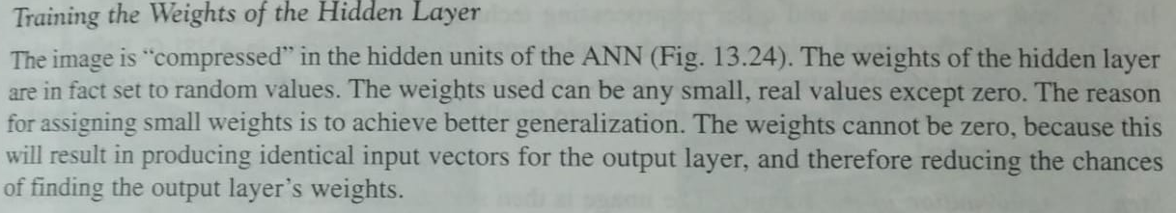
Training the weights of the Hidden Layer

Slide 111
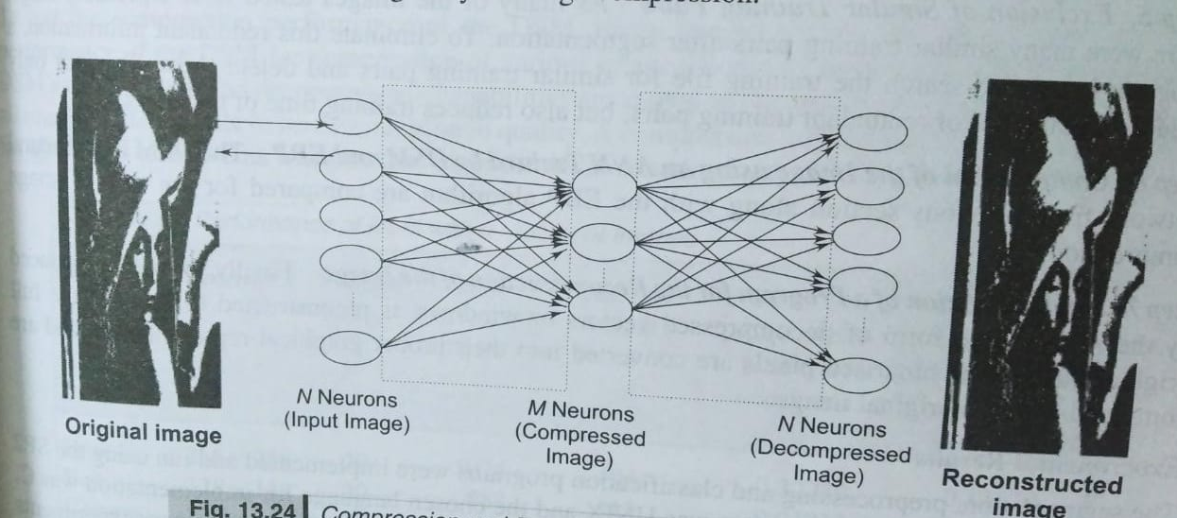
Compression and Decompression of Image within the ANN

Slide 112
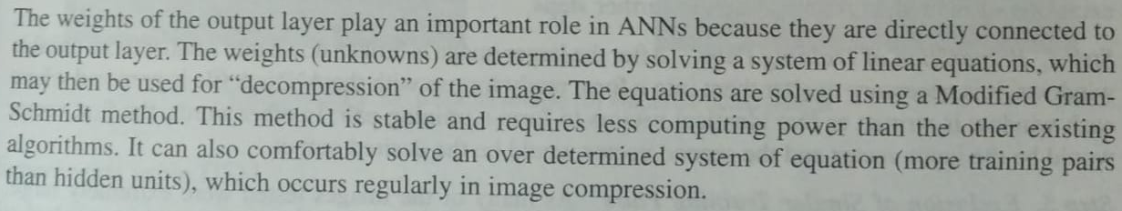
Training the Weights of the Output Layer

Slide 113
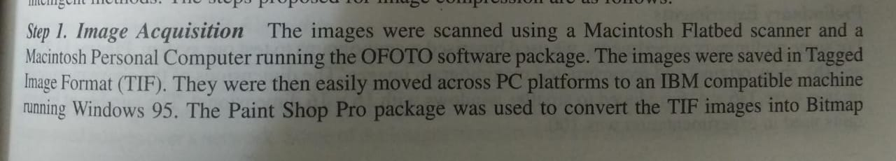
Algorithm for image Compression and Decompression
Many steps must be taken before an image can be successfully compressed using either conventional or intelligent methods. The steps proposed for image compression are as follows:

Slide 114
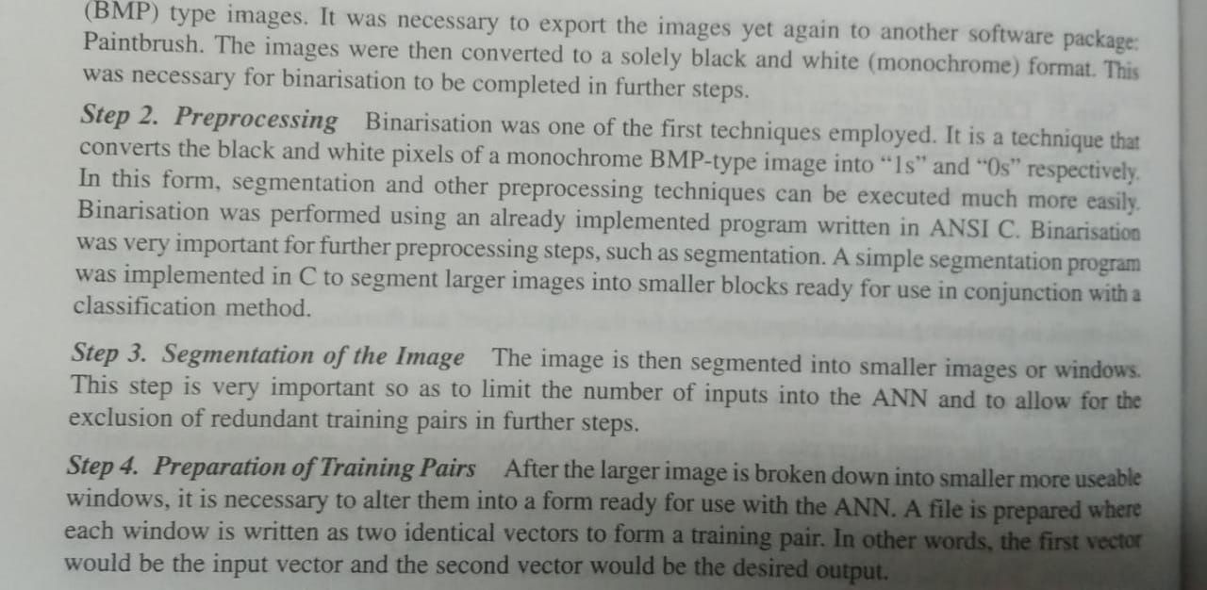
Algorithm for image Compression and Decompression

Slide 115
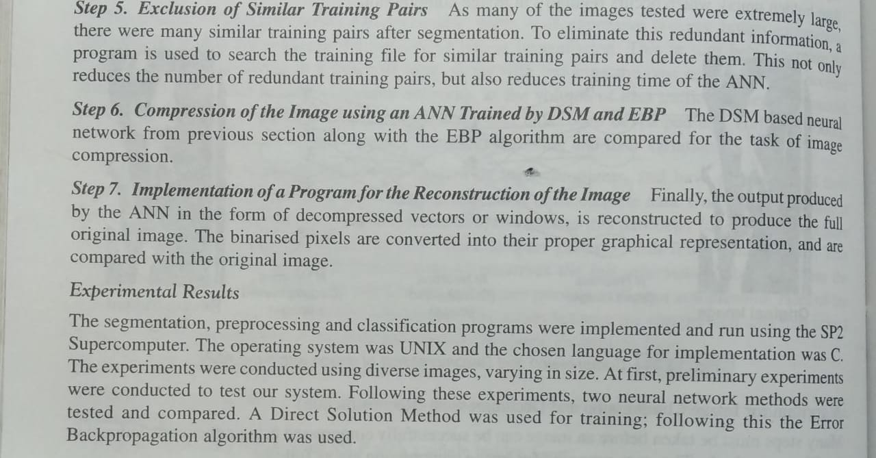
Algorithm for image Compression and Decompression

Slide 116
Neural Network in Robotics

Slide 117
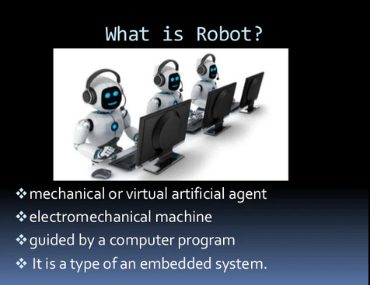
Neural Network in Robotics

Slide 118
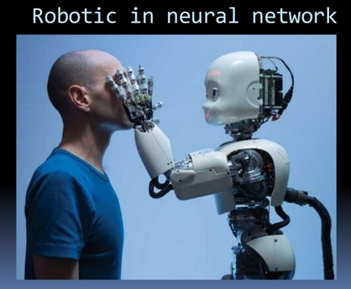
Neural Network in Robotics

Slide 119
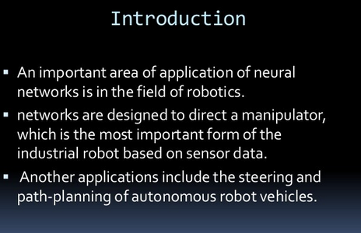
Neural Network in Robotics

Slide 120
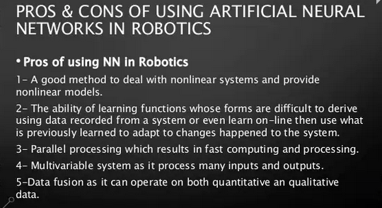
Neural Network in Robotics

Slide 121
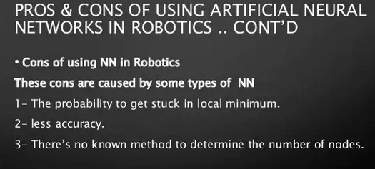
Neural Network in Robotics

Slide 122
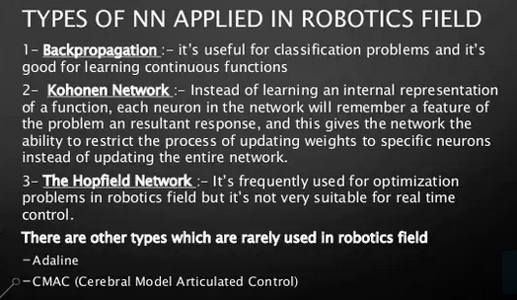
Neural Network in Robotics

Slide 123
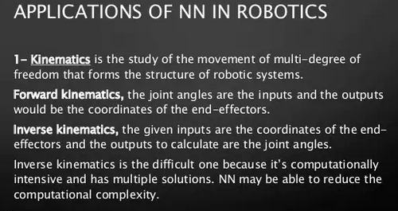
Neural Network in Robotics

Slide 124
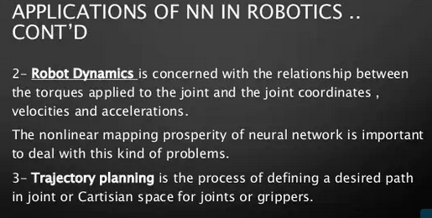
Neural Network in Robotics

Slide 125
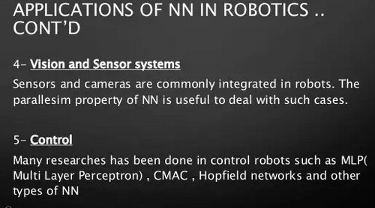
Neural Network in Robotics

Slide 126
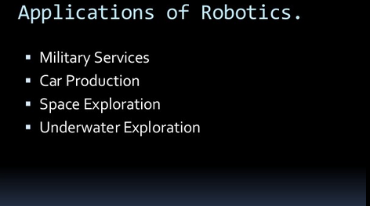
Neural Network in Robotics

